Slide 1


Project Management
( Team A )

Slide 2



Team Members

Slide 3
Alok Raj
Discussion
Introduction
Project Initiation
Time : 4 min

Slide 4
Prasansa Dahal
Discussion:
Belbin Analysis
Skill Audit
Microsoft Project
Time : 3 min

Slide 5
Susan Khatri
Discussion:
Team Meetings
Communication and Collaboration Tools
Requirements
Time : 5 mins

Slide 6
Dikson Rajbanshi
Discussion :
Entity Relationship Diagram
Extended Entity Relationship Diagram
Composite ERD
Time : 4 mins

Slide 7
Surya Shrestha
Discussion:
Use Case
Wireframe
Website Work in Progress
Time : 4 min

Slide 8
PROJECT LOGO

Slide 9
Overview
Cleckhudderfax Online Megastore is an online grocery store, which is being developed as a solution to the competition given by the national chains to the small local independent businesses at Cleckhuddersfax.
Given the fact that currently we are living in the information age where technologies are blooming, online markets are growing widely due to ease of use and better accessibility.
Cleckhudderfax Online Megastore aims to be the solution for tackling the current issue at hand and provide the local shops with wider range of usage along with providing the customers with better shopping experience.

Slide 10

Project Course
Current Position
Project Initiation
Closing
Project Execution
Project Planning
Monitoring &
Testing

Slide 11
Project Justification
Project Scope
Requirements
Duration
Estimated Budget
Roles and Responsibilities
Communication
and
Collaboration Tools

Slide 12
Project Organization
Members
Dikson Rajbanshi
Alok Raj
Surya Shrestha
Susan khatri
Prasansa Dahal
Communications
Members will provide status updates during team meetings and any additional communications will be done through Slack or through phone calls
Planning/Tracking
Trello
Slack
GitHub

Slide 13

Belbin Analysis
Shaper,
Team Worker, Plant
Alok Raj
Resource Investigator,
Implementer, Shaper
Susan Khatri

Slide 14

Coordinator,
Specialist, Monitor Evaluation
Dikson Rajbanshi
Specialist,
Complete Finisher, Plant
Prasansa Dahal
Implementer,
Resource Investigator, Complete Finisher
Surya Shrestha

Slide 15

Skill Audit

Slide 16
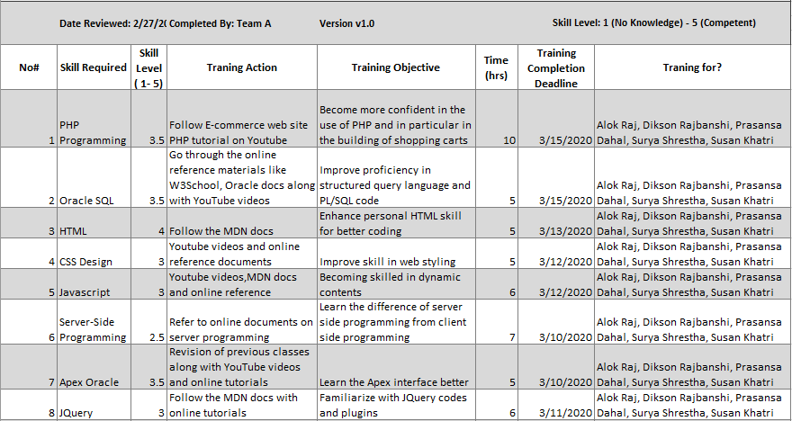

Slide 17
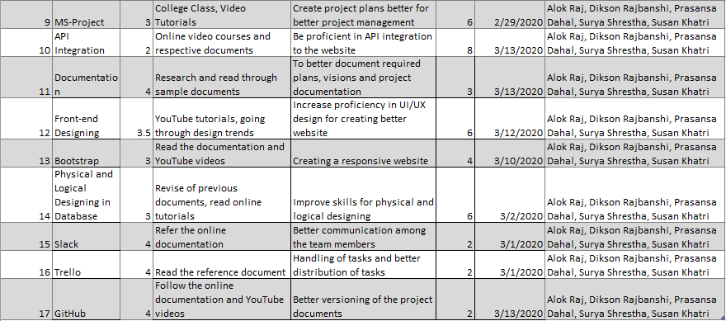

Slide 18

Microsoft Project

Slide 19
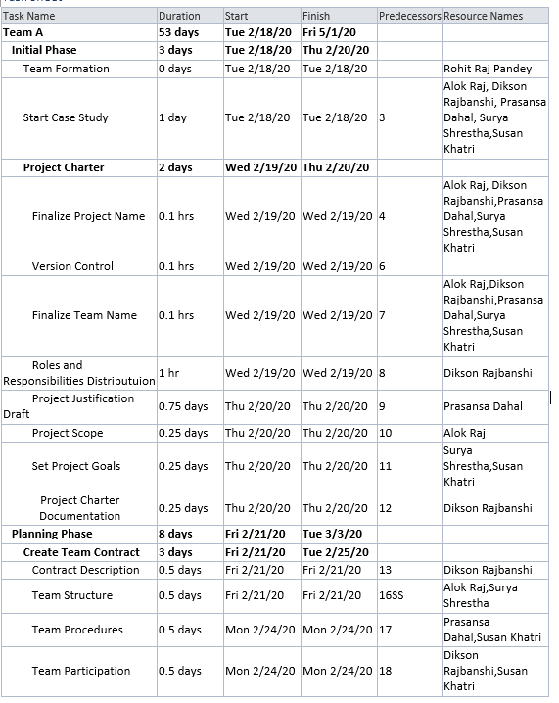
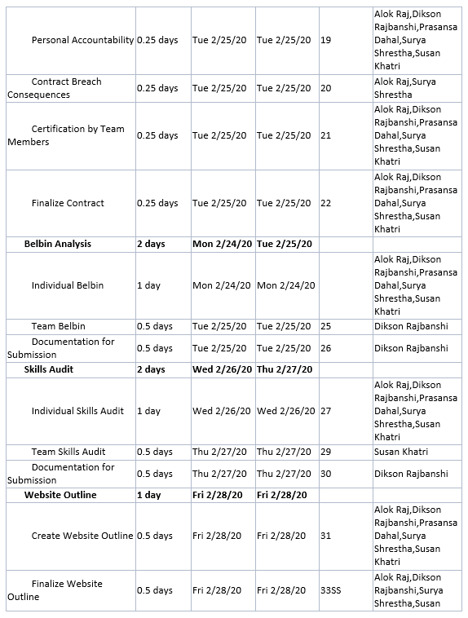
Task Sheet

Slide 20
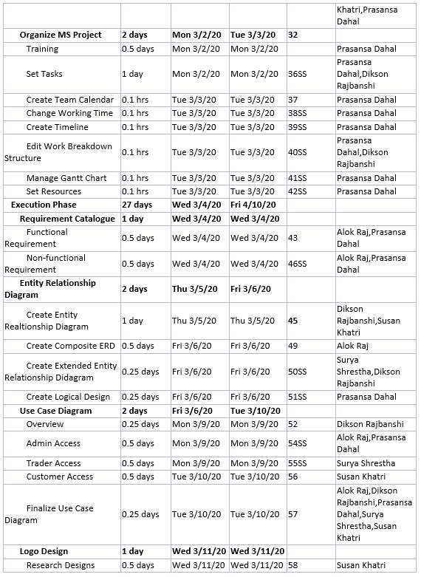
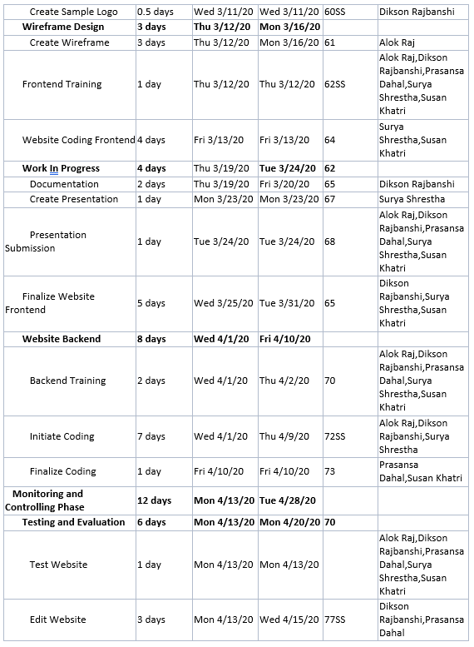
Task Sheet

Slide 21
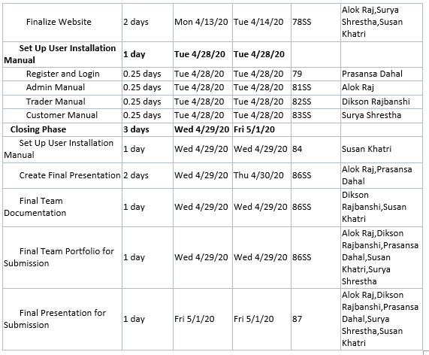
Task Sheet

Slide 22
Resource Sheet

Slide 23
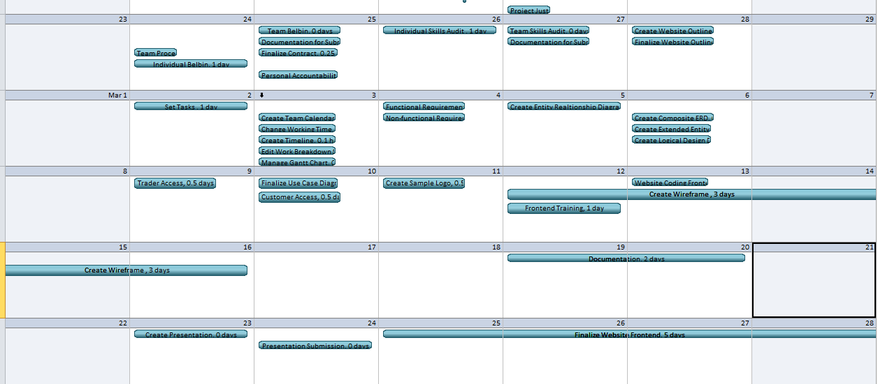
Calendar

Slide 24
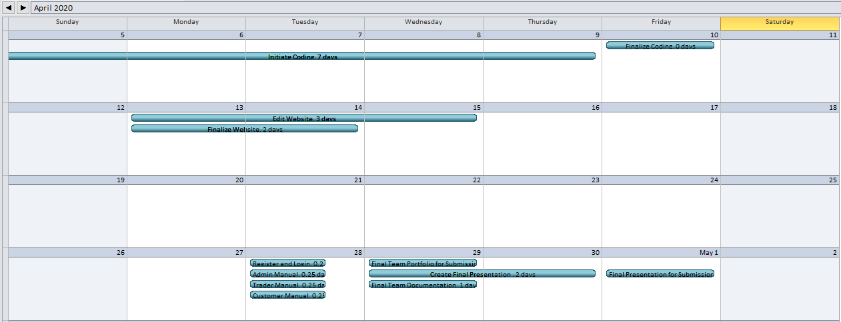
Calendar

Slide 25
Timeline

Slide 26

Team Meetings

Slide 27



Communication and Collaboration Tools
Trello
Slack
GitHub

Slide 28
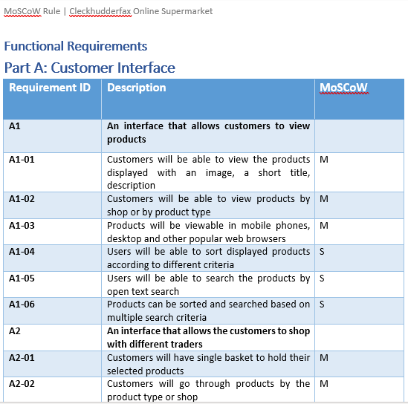
Requirement Catalogue

Slide 29
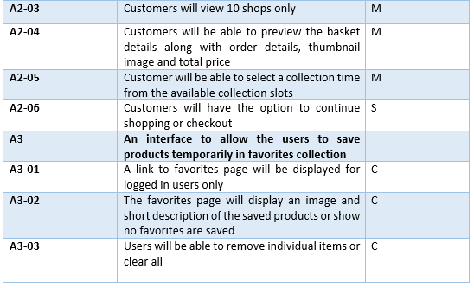

Slide 30
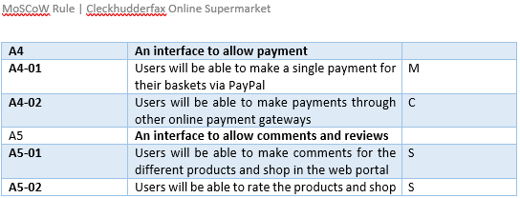

Slide 31
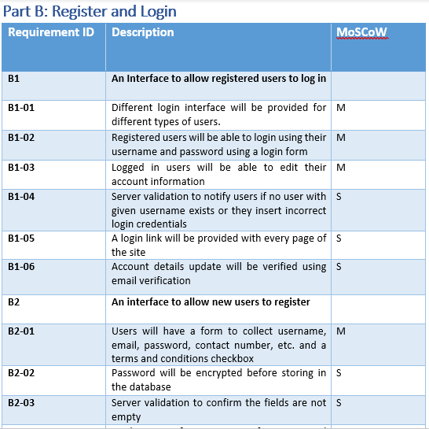

Slide 32
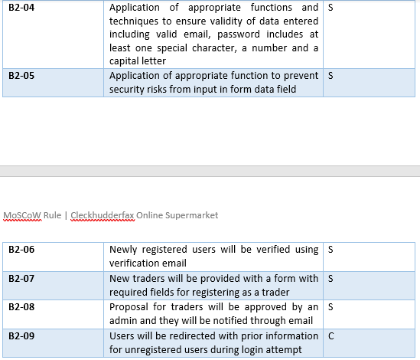

Slide 33
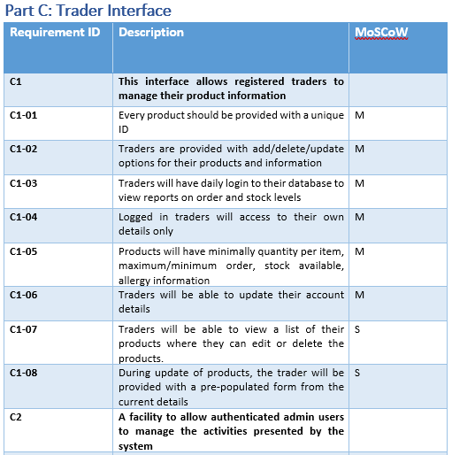

Slide 34
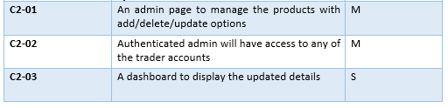

Slide 35
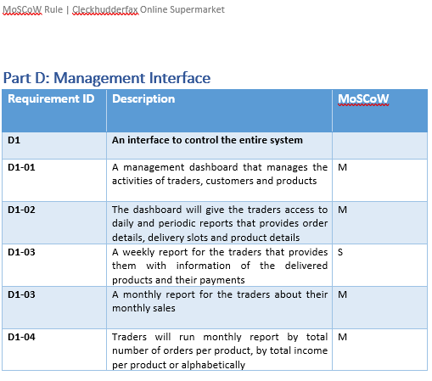

Slide 36
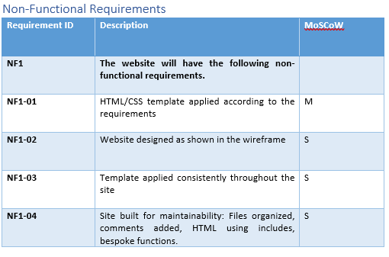

Slide 37
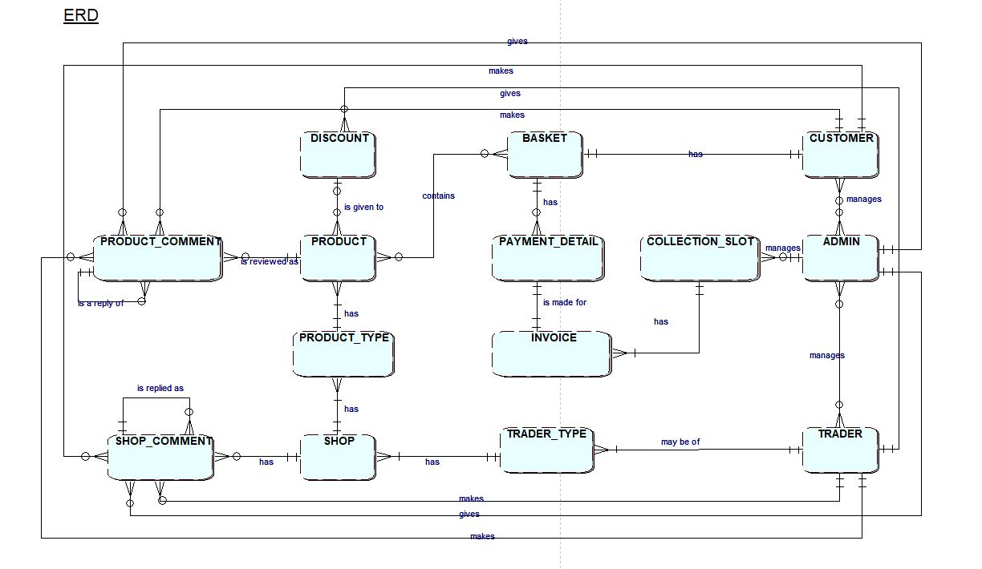
Entity Relationship Diagram

Slide 38
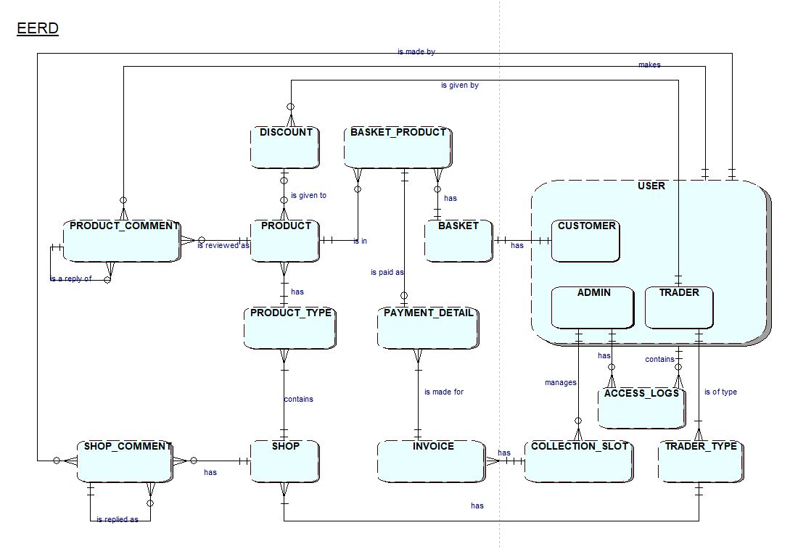
Extended Entity Relationship Diagram

Slide 39
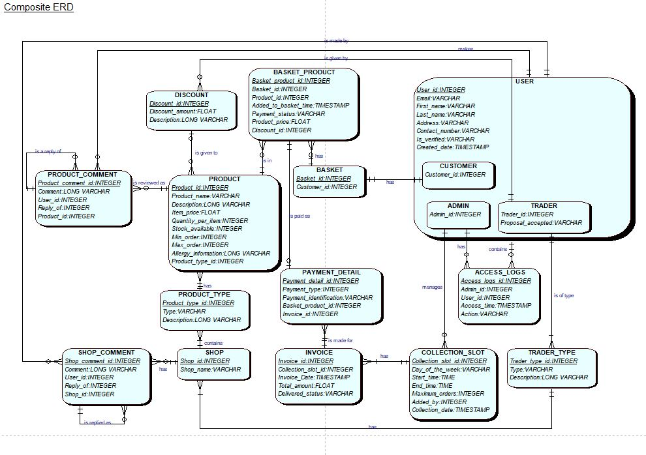
Composite Diagram

Slide 40
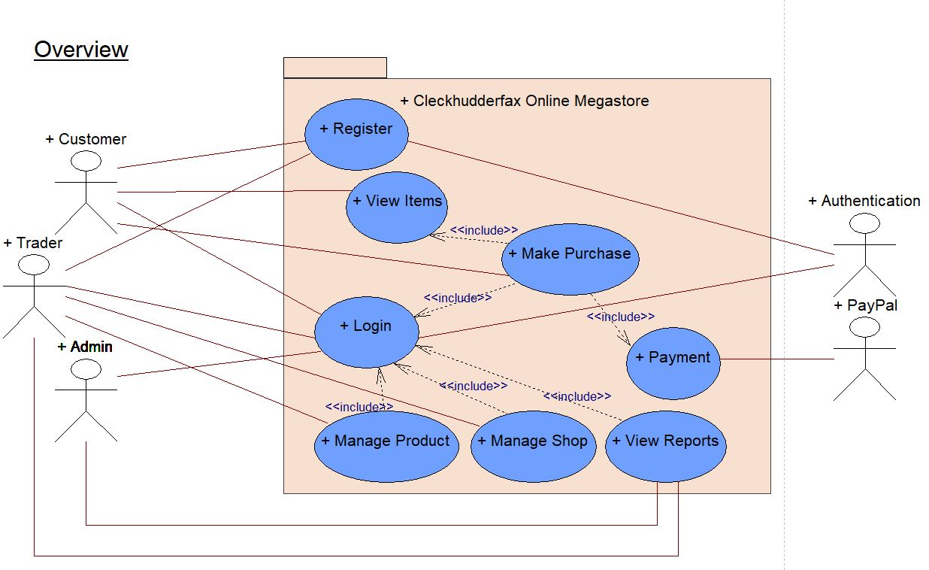
Overview Design

Slide 41
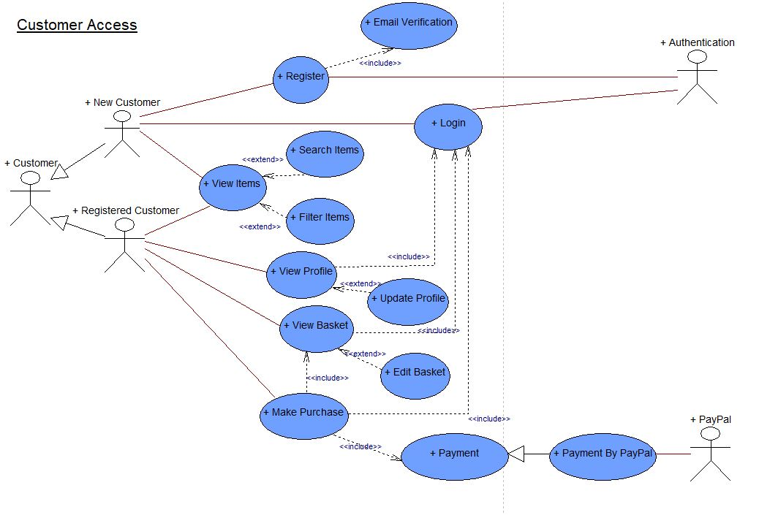
Use Case Diagram
Customer Use Case Diagram

Slide 42
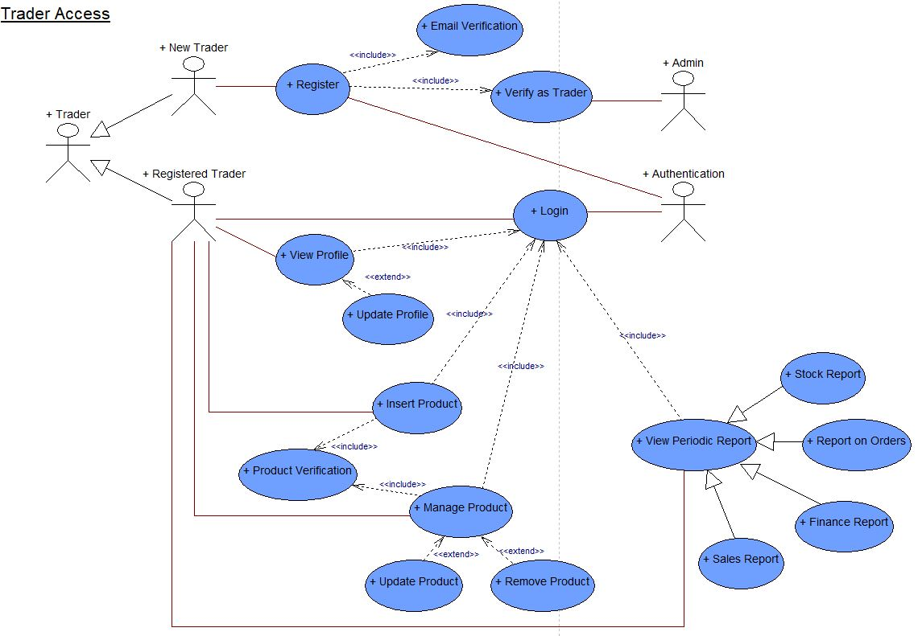
Use Case Diagram
Trader Use Case Diagram

Slide 43
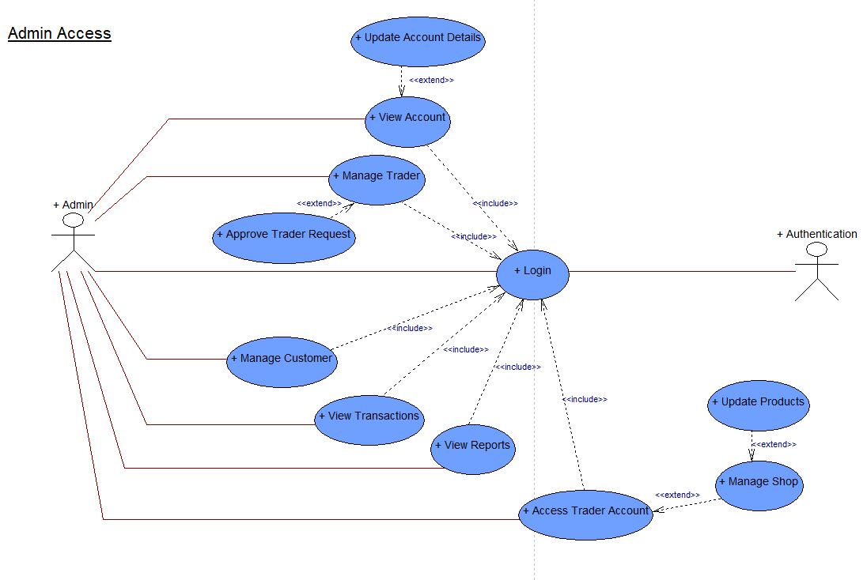
Use Case Diagram
Admin Use Case Diagram

Slide 44
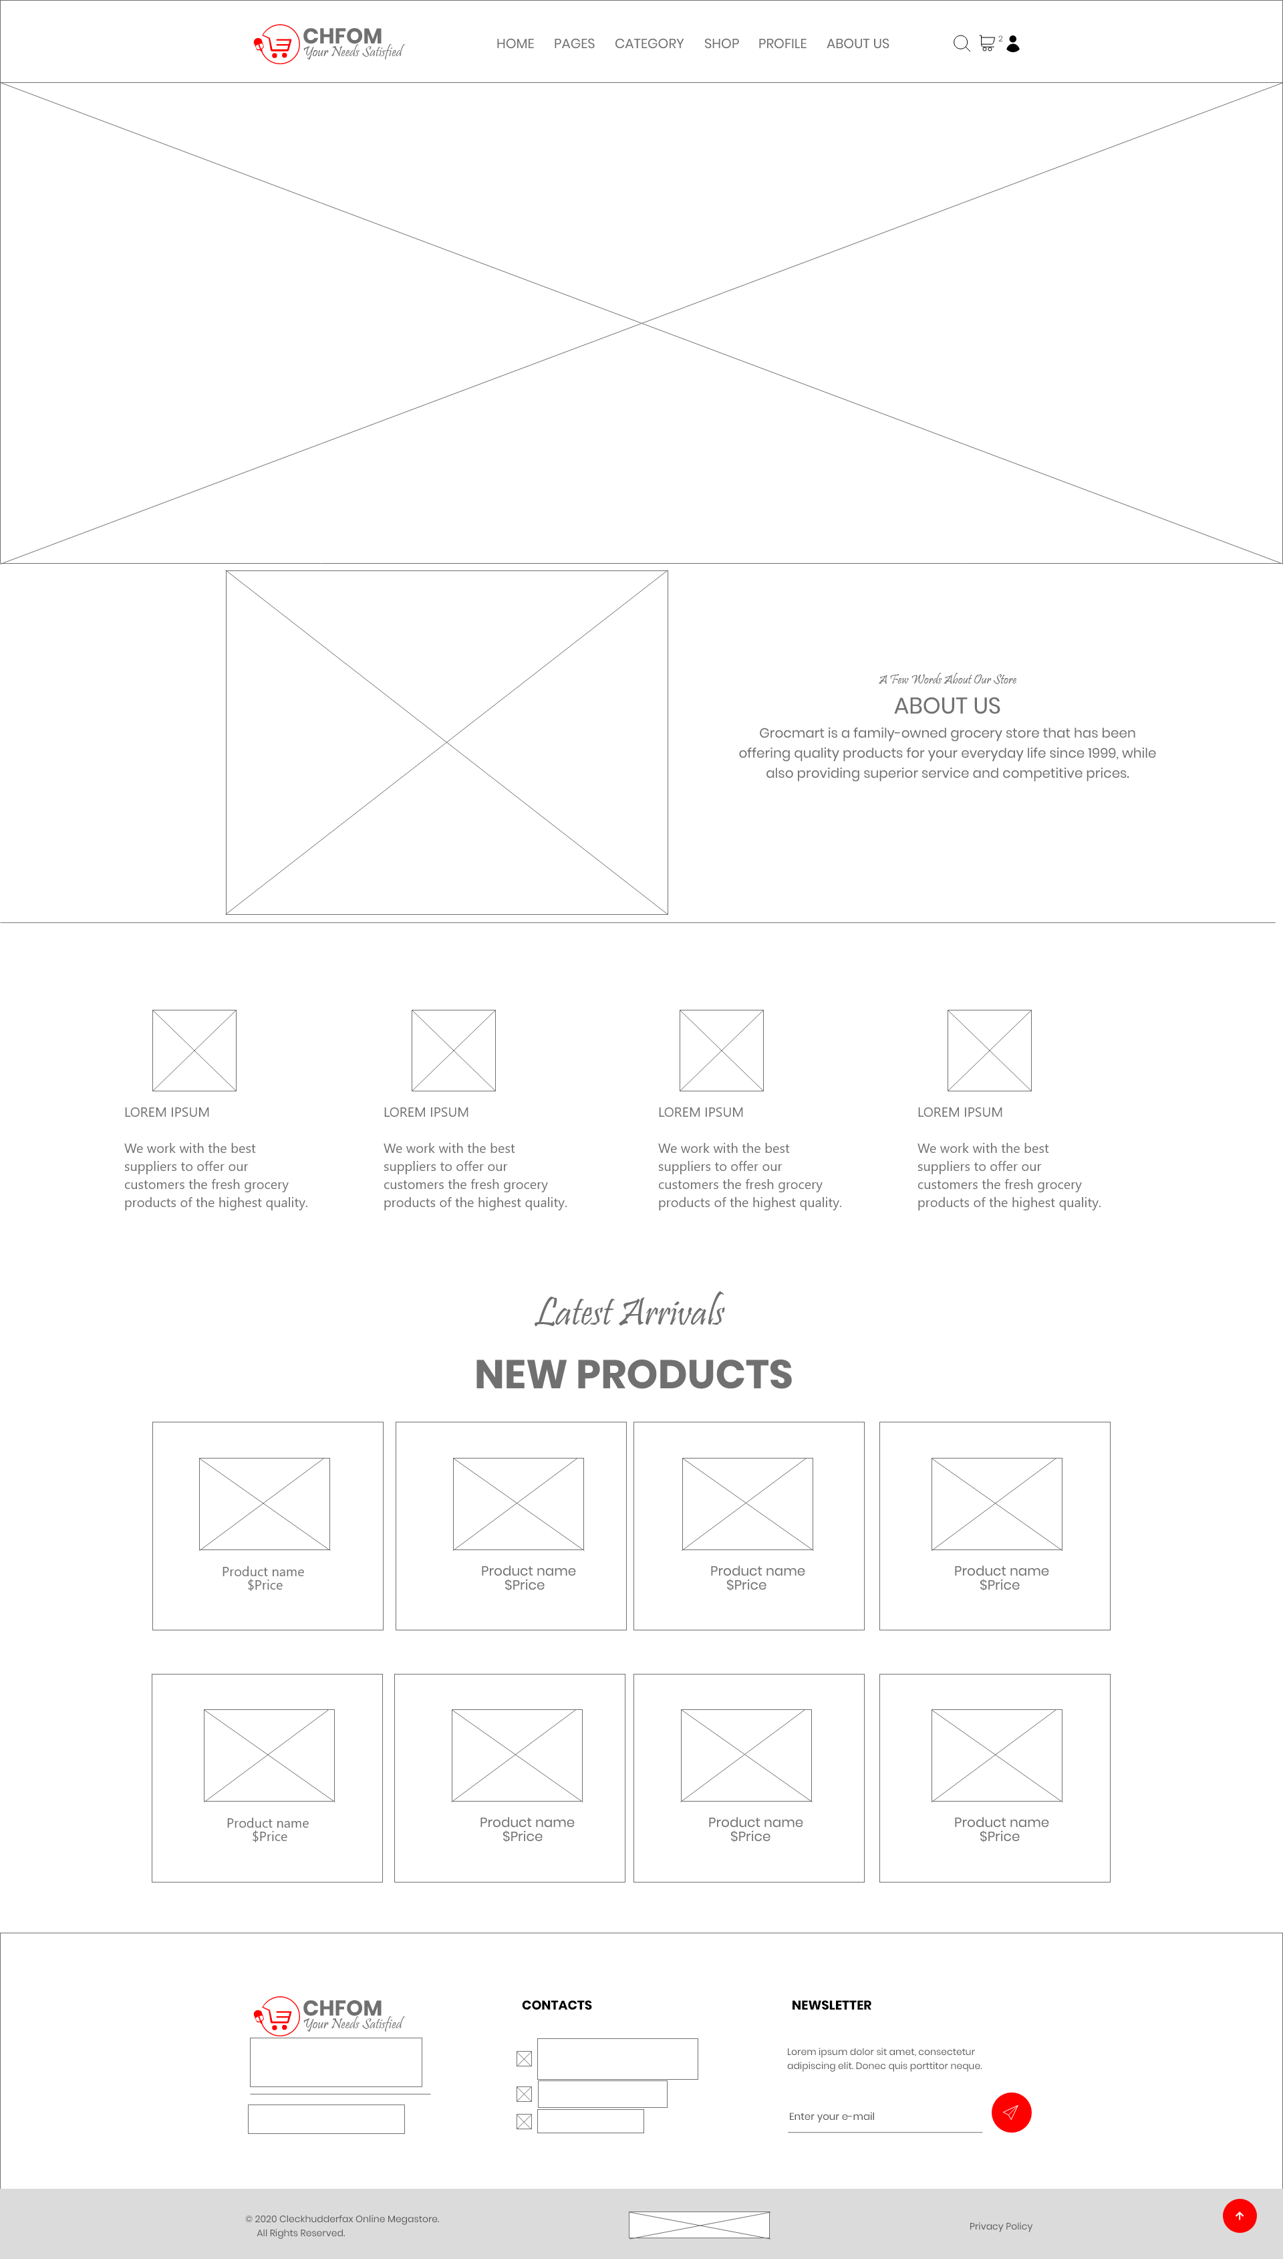
Wireframe (Homepage)
Notes:
User friendly
Easy to use
Minimal

Slide 45
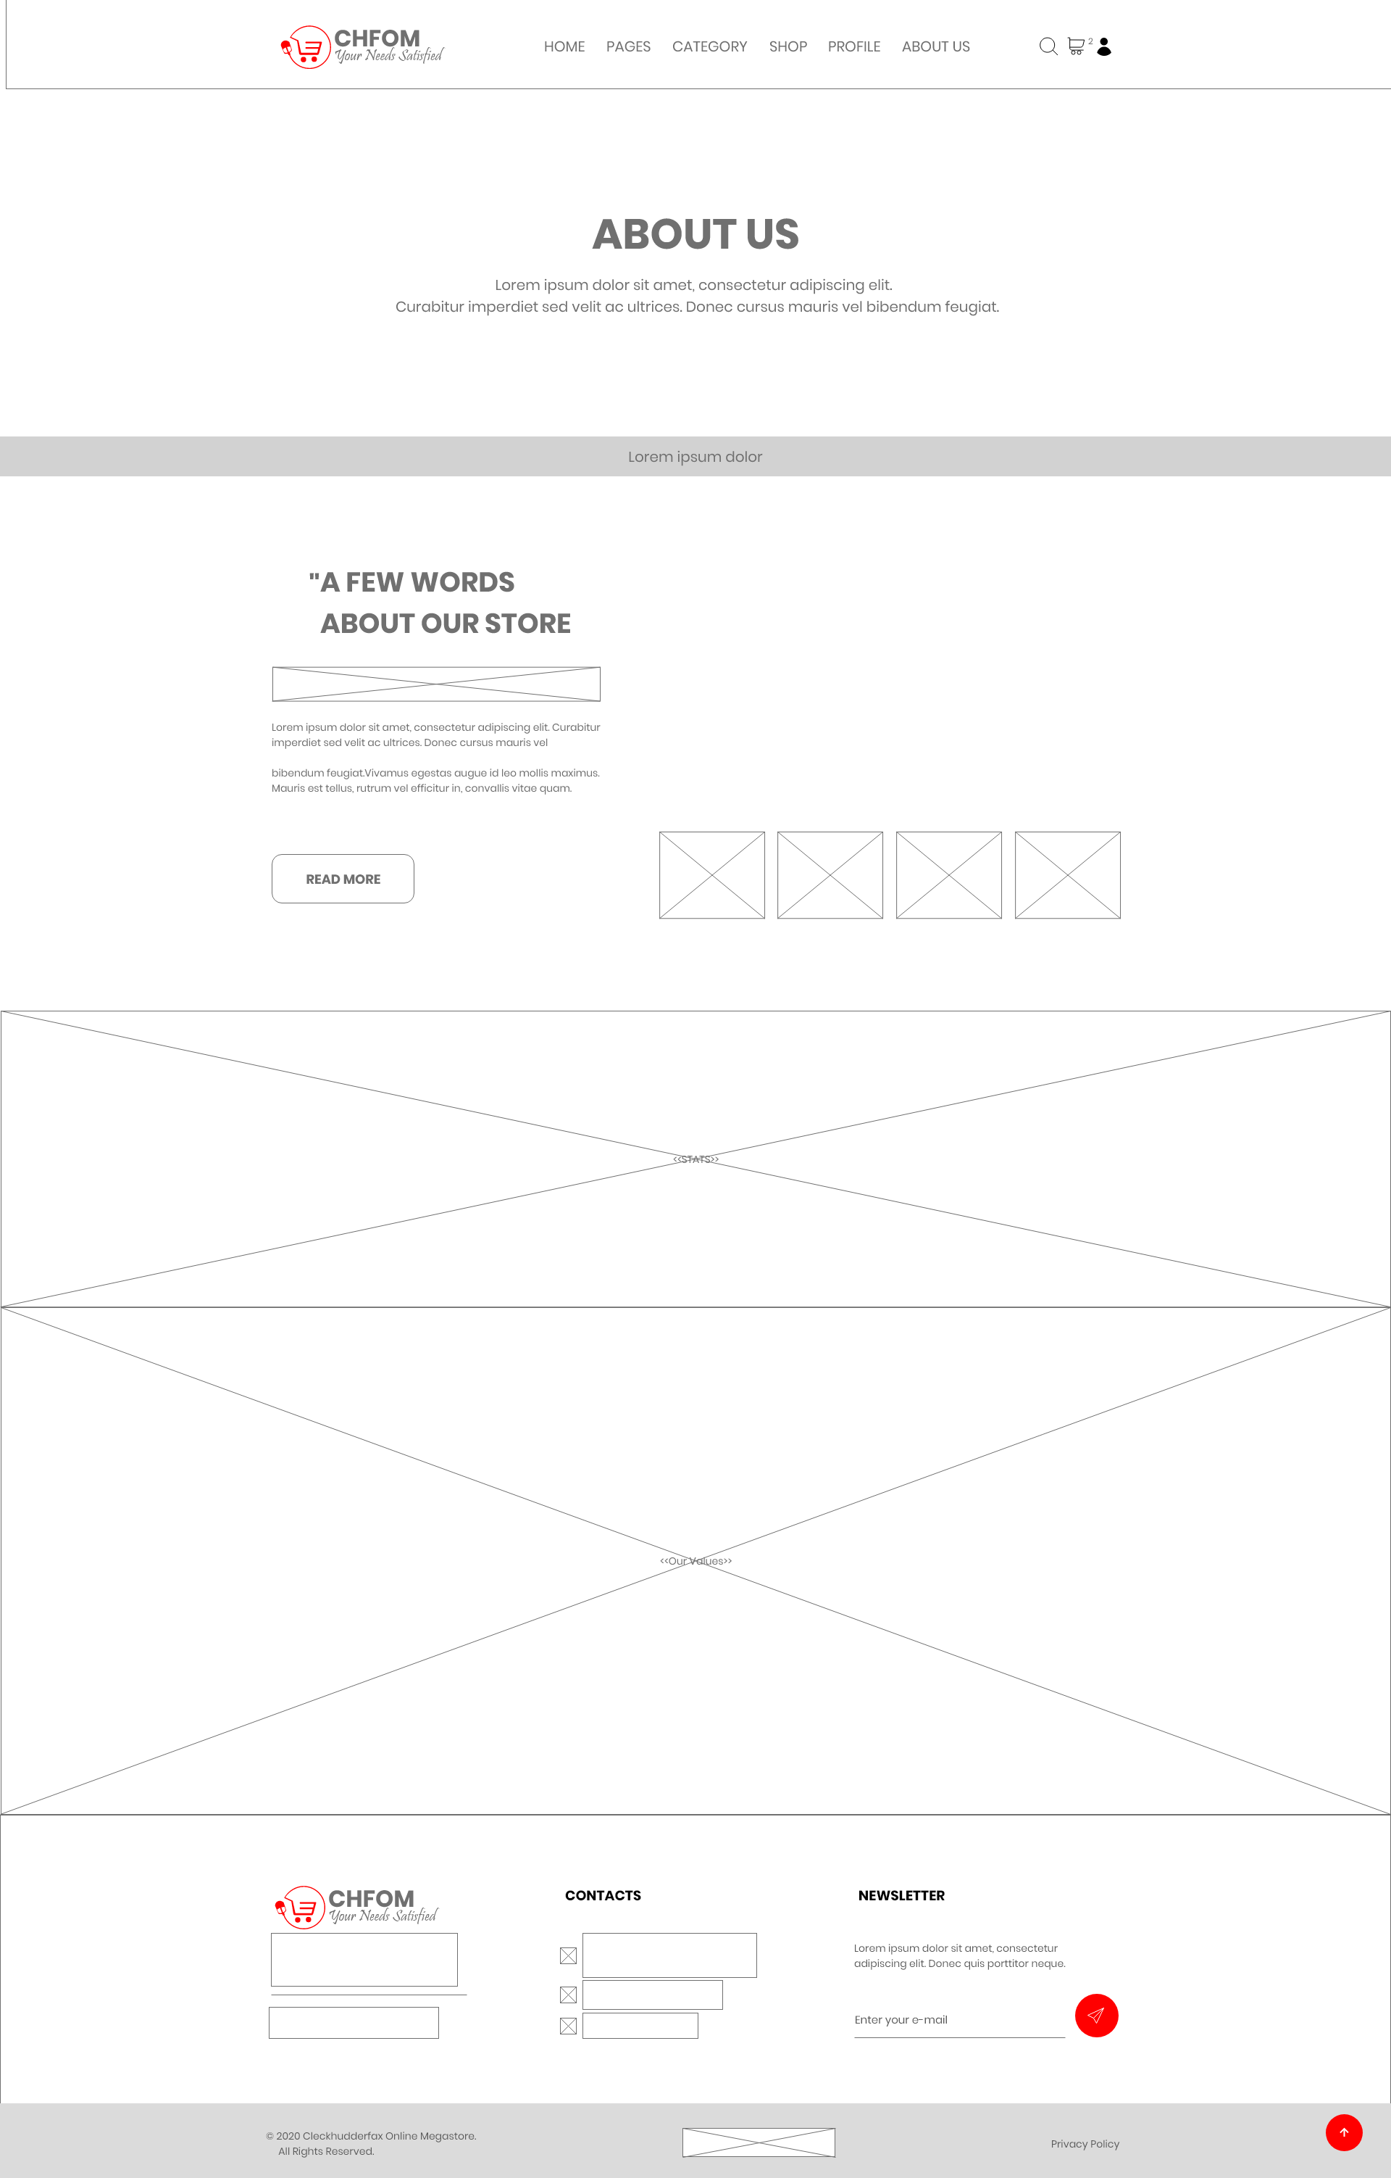
Wireframe (About Us)
Notes:
User friendly
Easy to use
Minimal

Slide 46
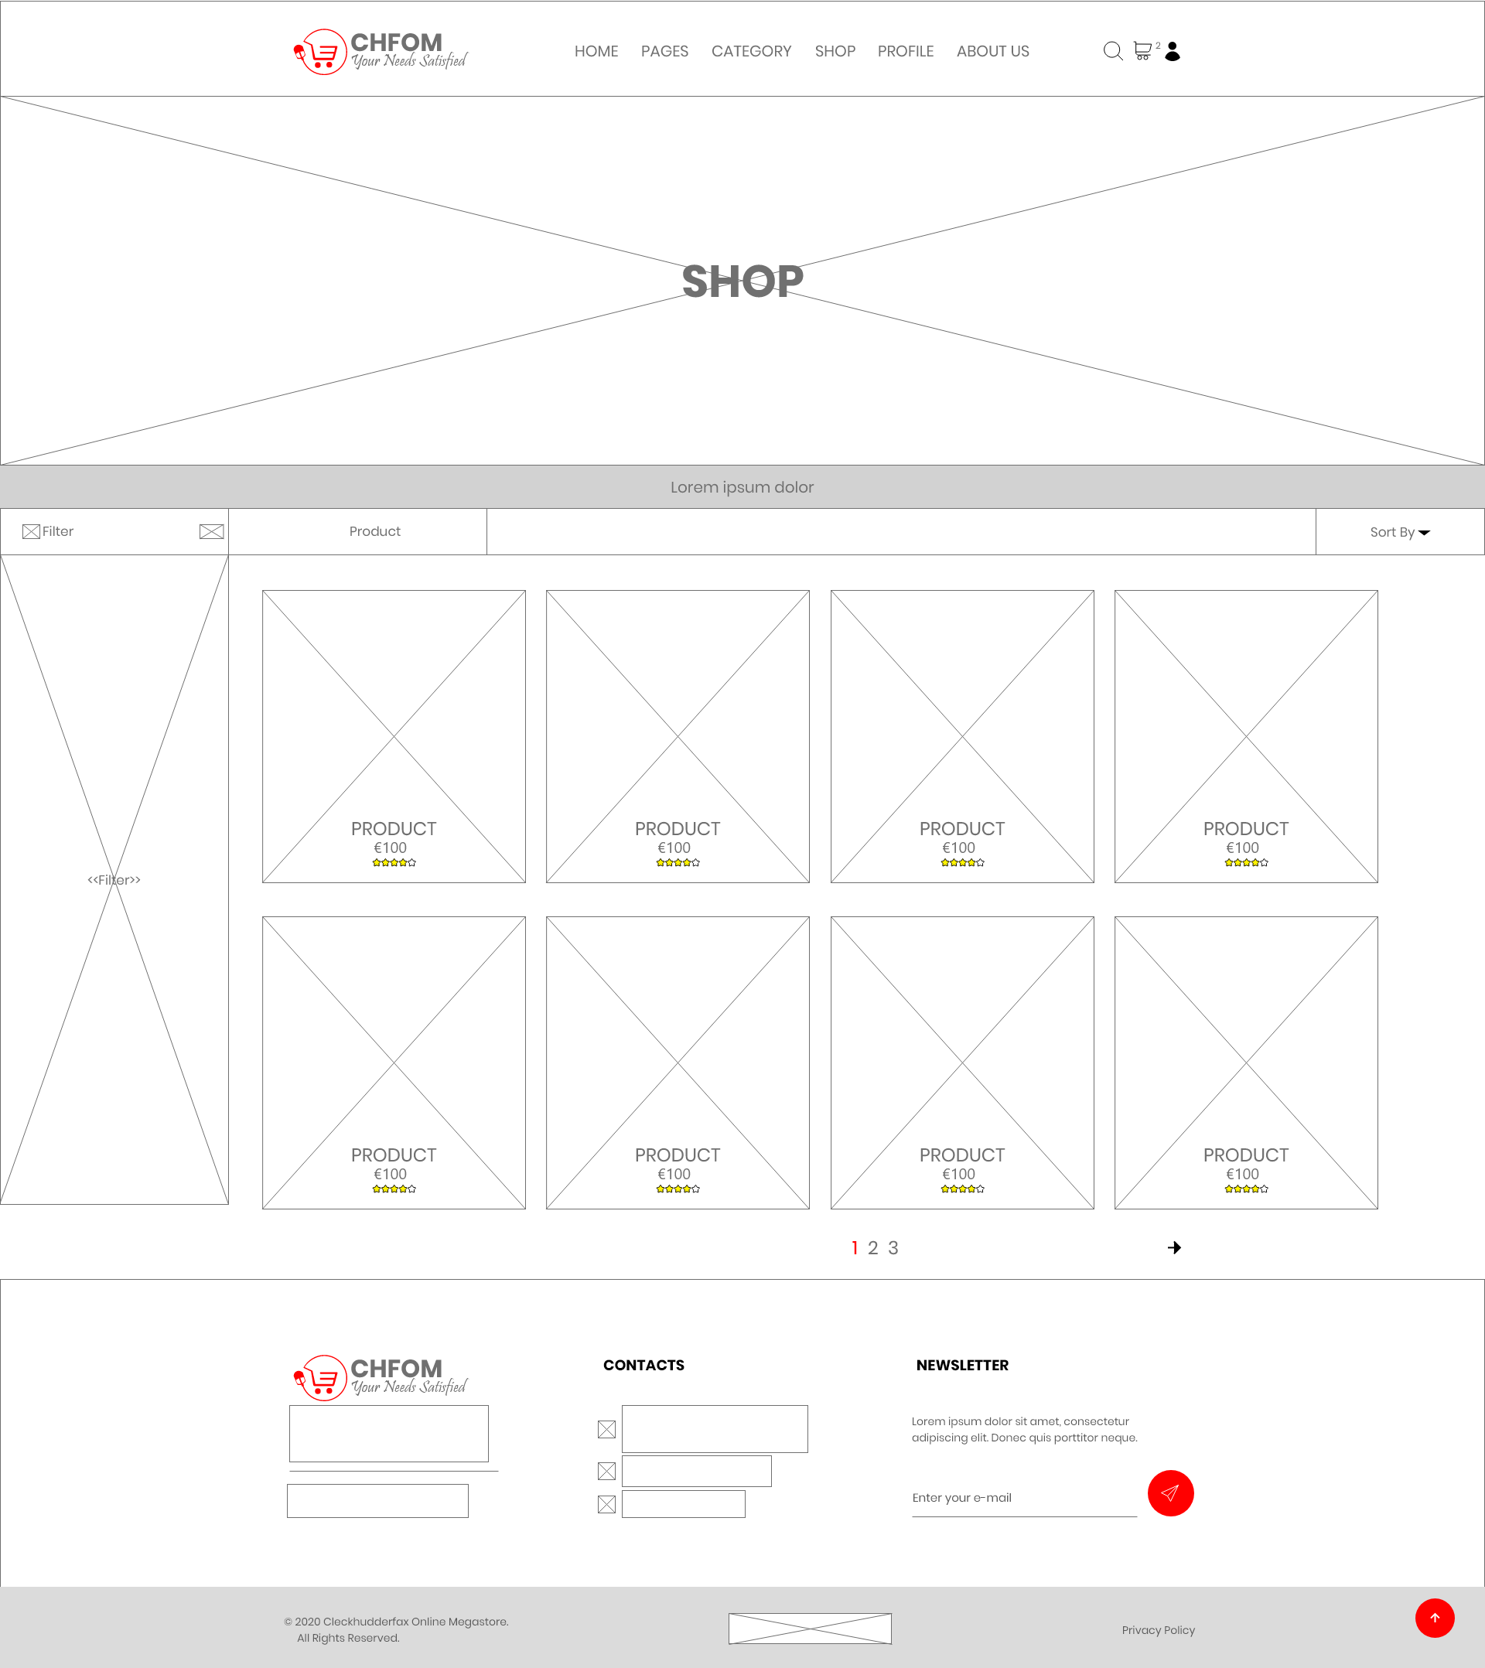
Wireframe (Shop)
Notes:
User friendly
Easy to use
Minimal

Slide 47
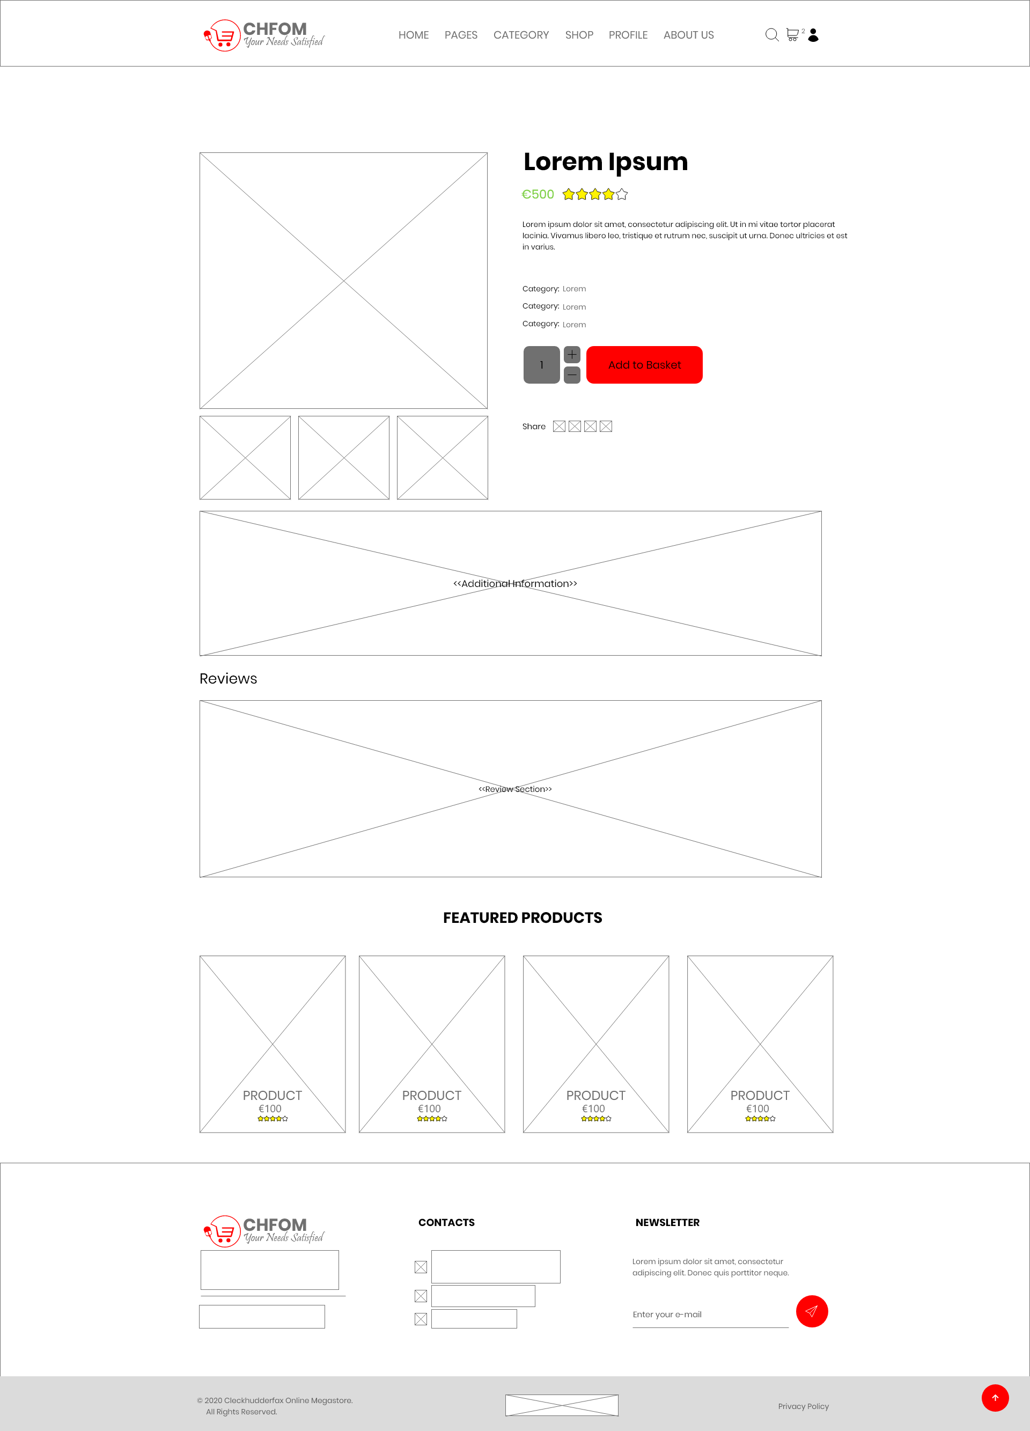
Wireframe (Single Product Page)
Notes:
User friendly
Easy to use
Minimal

Slide 48
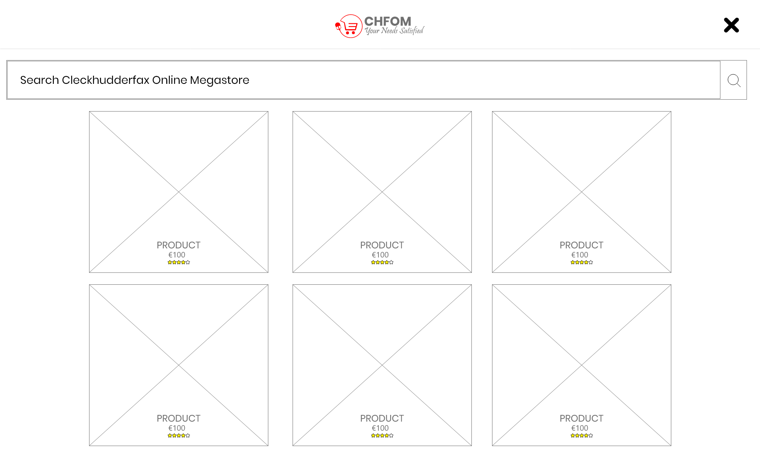
Wireframe (Search)
Notes:
User friendly
Easy to use
Minimal

Slide 49
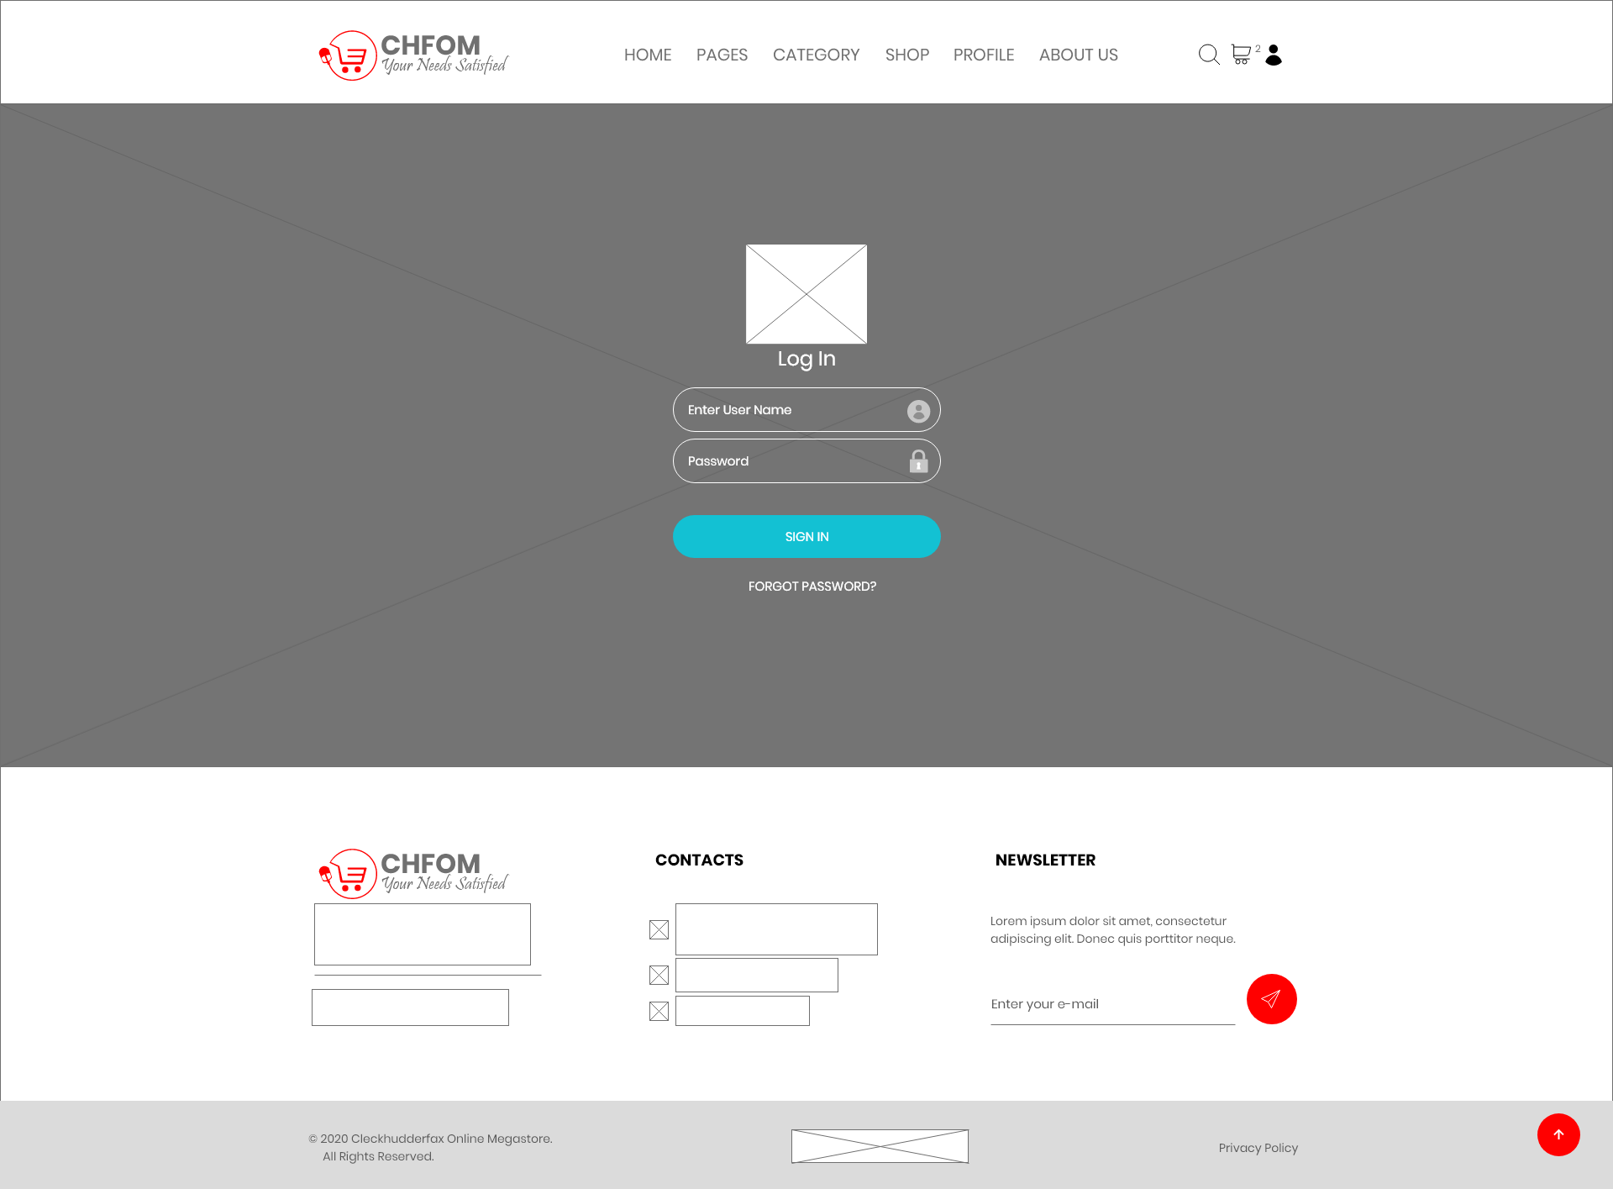
Wireframe (Login)
Notes:
User friendly
Easy to use
Minimal

Slide 50
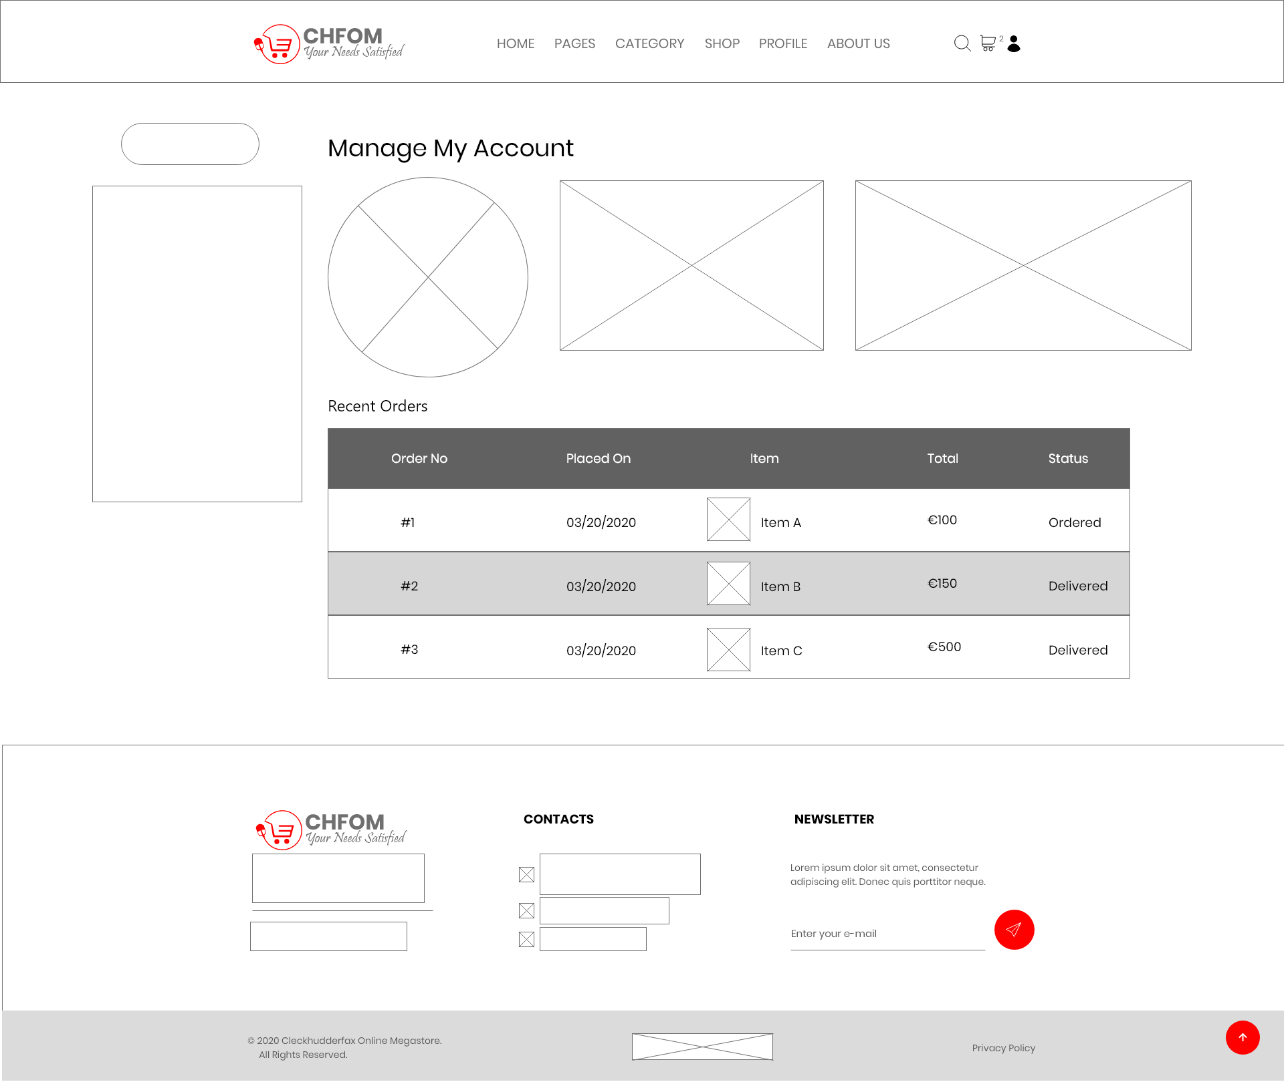
Wireframe (Customer Profile)
Notes:
User friendly
Easy to use
Minimal

Slide 51
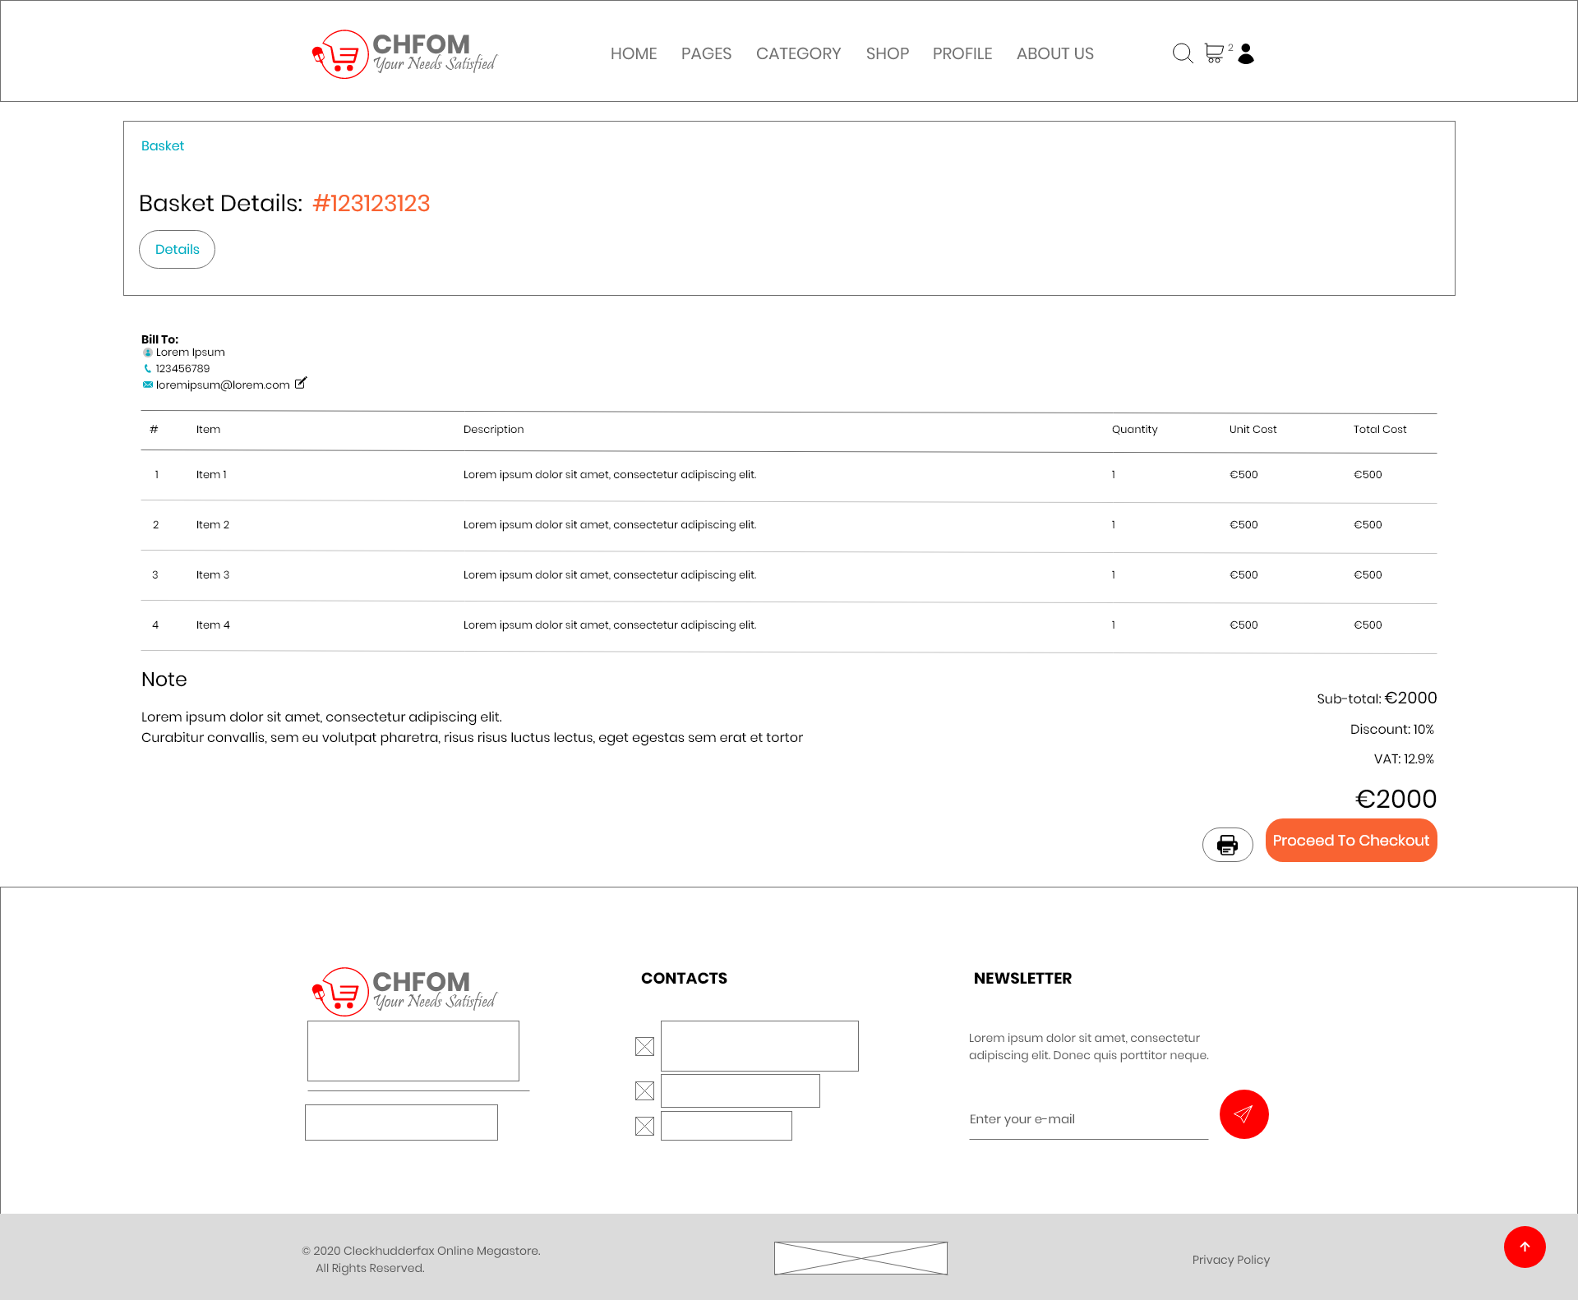
Wireframe (Basket Overview)
Notes:
User friendly
Easy to use
Minimal

Slide 52
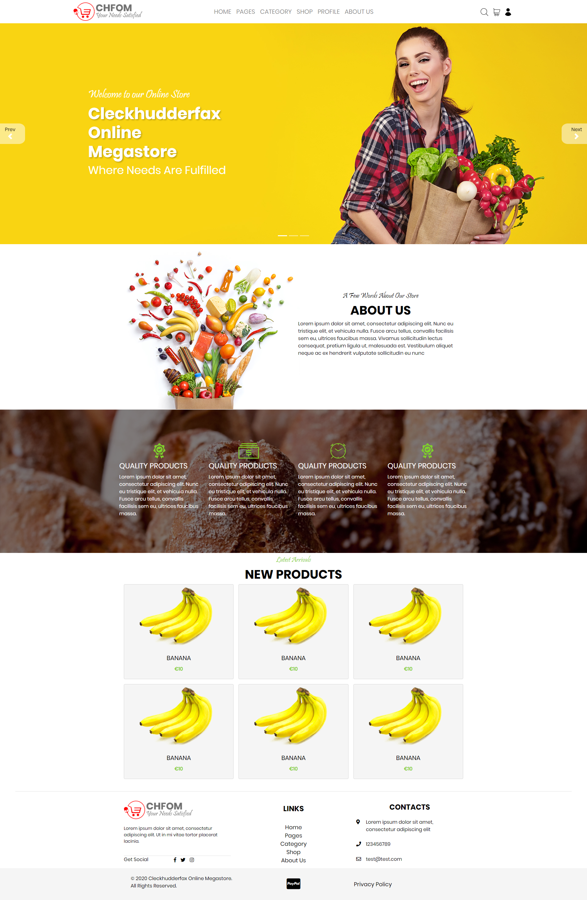
Work in Progress (Homepage)

Slide 53
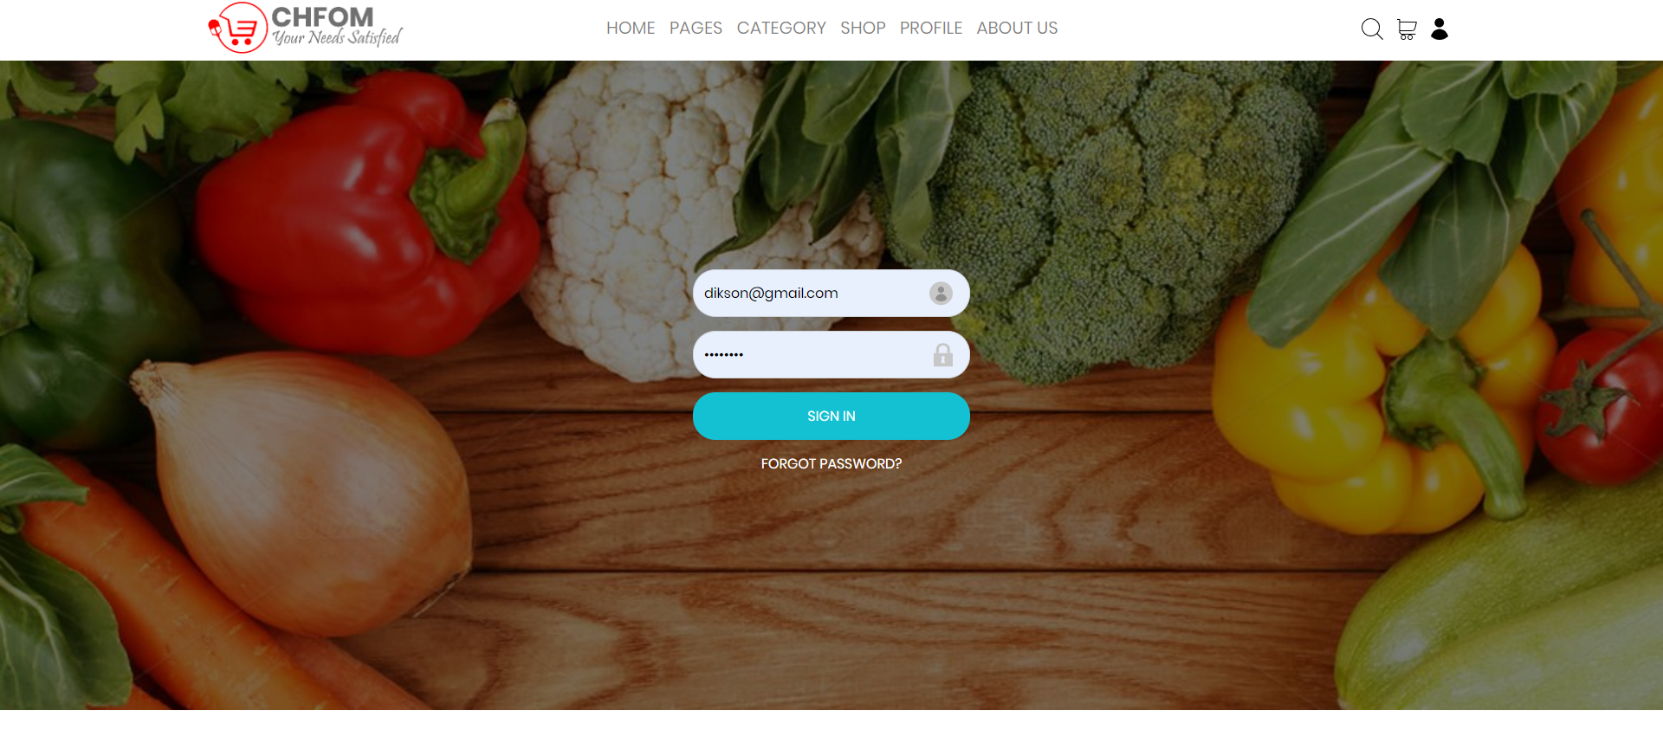
Work in Progress (Login)

Slide 54
Thank you.

